Slide 1

6th Grade Accelerated Math
Unit 2, Lesson 1 Equivalent Conversions: Fractions ↔ Decimals; Decimals ↔ Percentages Volume 1, pg. 41

Slide 2


Benchmark
MA.6.NSO.3.5
Rewrite positive rational numbers in different but equivalent forms including fractions, terminating decimals, and percentages.
volume 1, pg. 41

Slide 3
Integrated Mathematical Thinking and Reasoning Standards
MA.K12.MTR.3.1 Complete tasks with mathematical fluency.
volume 1, pg. 41

Slide 4

Learning Target(s)
I can convert between fractions and decimals.
I can convert between percentages and decimals.
volume 1, pg. 41

Slide 5

Warm-Up
volume 1, pg. 41

Slide 6
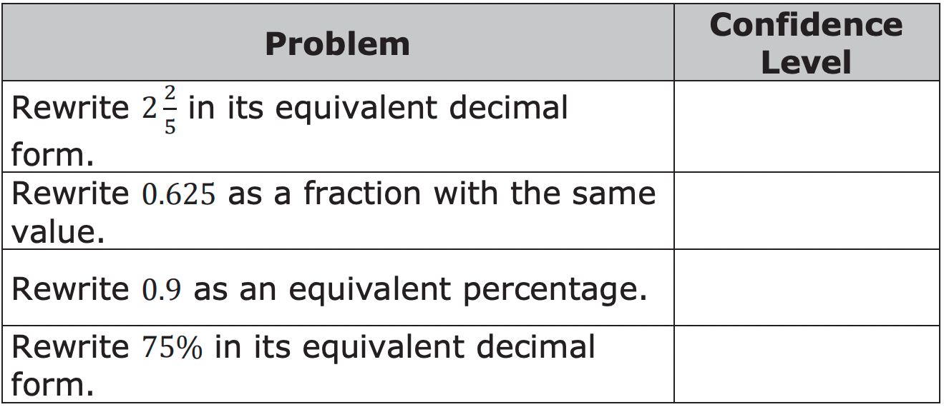
2.1.1 Warm-Up: Self-Evaluation
1. For each problem, rate your level of confidence in your ability to answer each question, but don’t actually answer them.
Use a scale from 1 to 5, where 1 means you do not feel confident about how to answer the question, and 5 means you feel very confident.
volume 1, pg. 41

Slide 7

Guided Instruction
volume 1, pg. 42

Slide 8
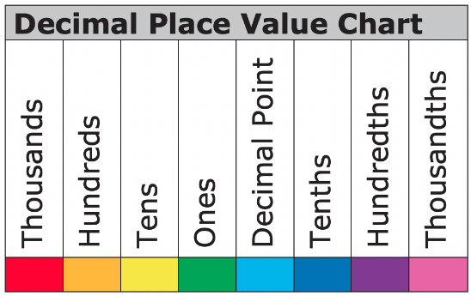
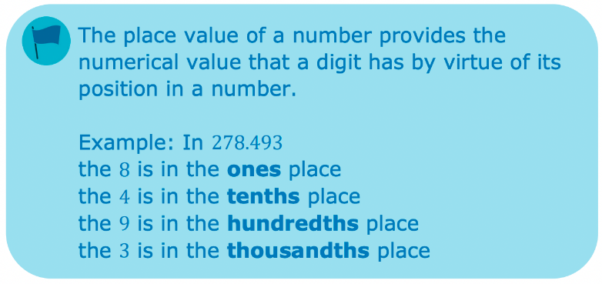
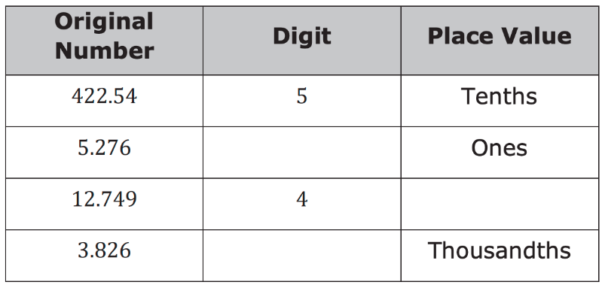
2.1.2 Guided Instruction: Fraction and Decimal Conversions
Use the original number to fill in the missing digits and place values.
volume 1, pg. 42

Slide 9
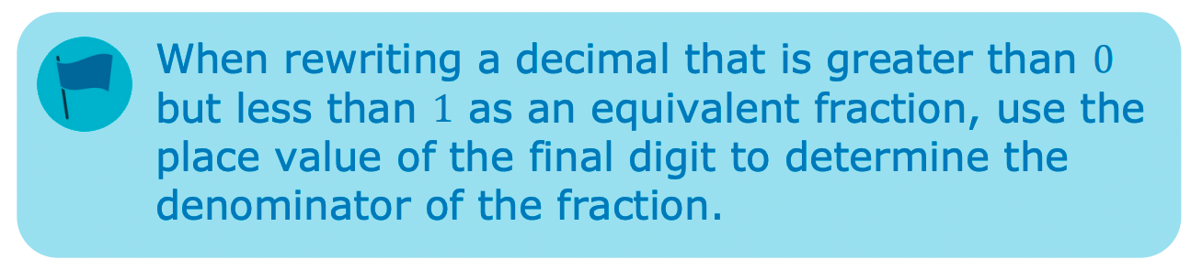
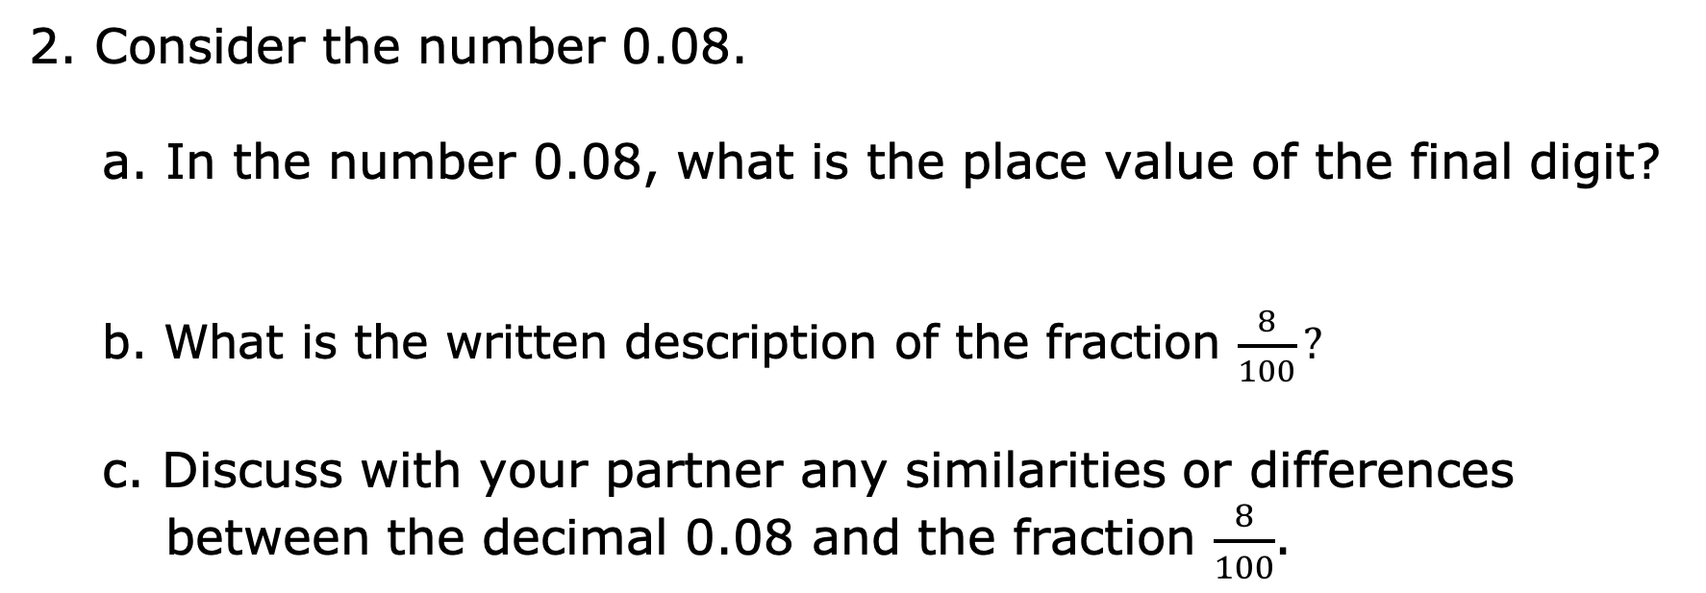
2. Consider the number 0.08.
a. In the number 0.08, what is the place value of the final digit?
b. What is the written description of the fraction $\frac{8}{100}?$
c. Discuss with your partner any similarities or differences between the decimal 0.08 and the fraction $\frac{8}{100}$.
volume 1, pg. 42

Slide 10
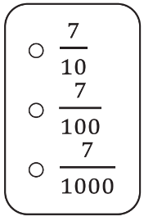
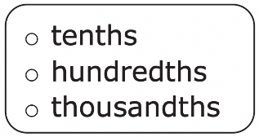
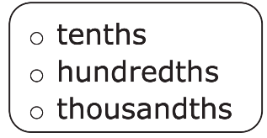
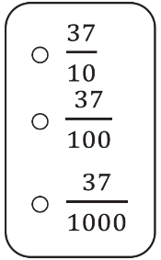
3. In the decimal 0.7, the final digit is in the
place, so
is the equivalent
fraction form.
4. In the decimal 0.037, the final digit is in the
place, so
is the equivalent
fraction form.
volume 1, pg. 43

Slide 11
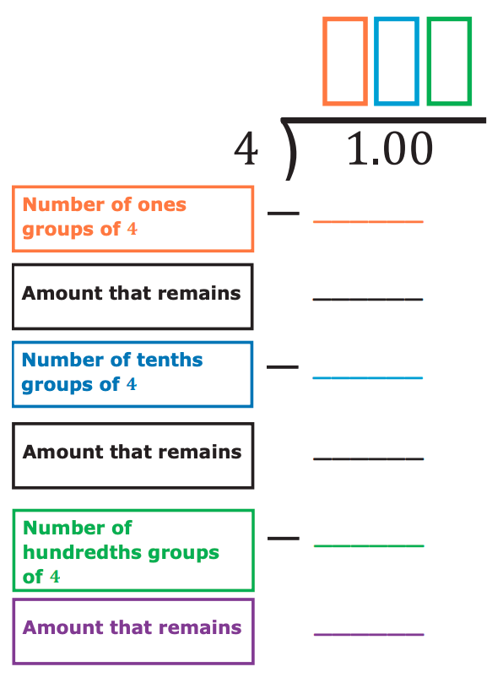
A fraction can be converted into its equivalent decimal form by dividing the numerator by the denominator.
5. To convert the fraction 1/4 to a decimal, divide 1 by 4 by completing the diagram below.
volume 1, pg. 43

Slide 12

Guided Practice
volume 1, pg. 44

Slide 13

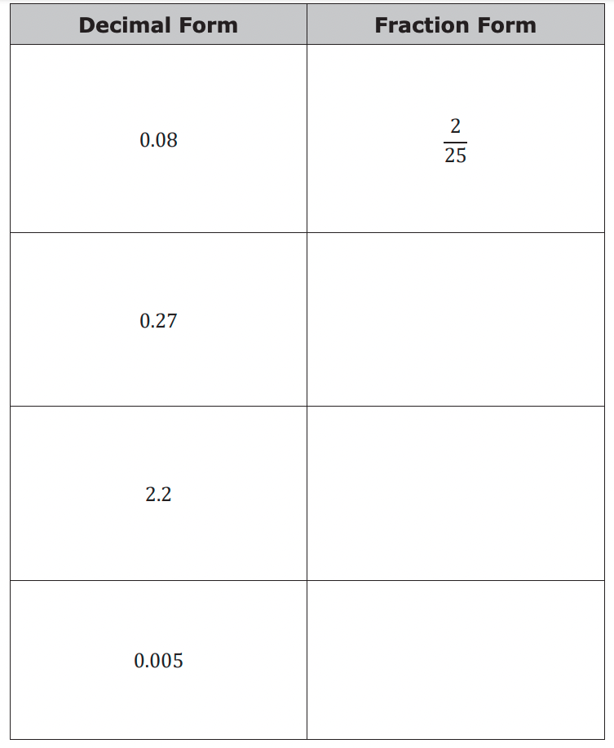
2.1.3 Guided Practice: Fraction and Decimal Conversions
Complete the table by converting each decimal to an equivalent fraction. If possible, write the equivalent fraction so that the numerator and denominator have no common factors.
volume 1, pg. 44

Slide 14
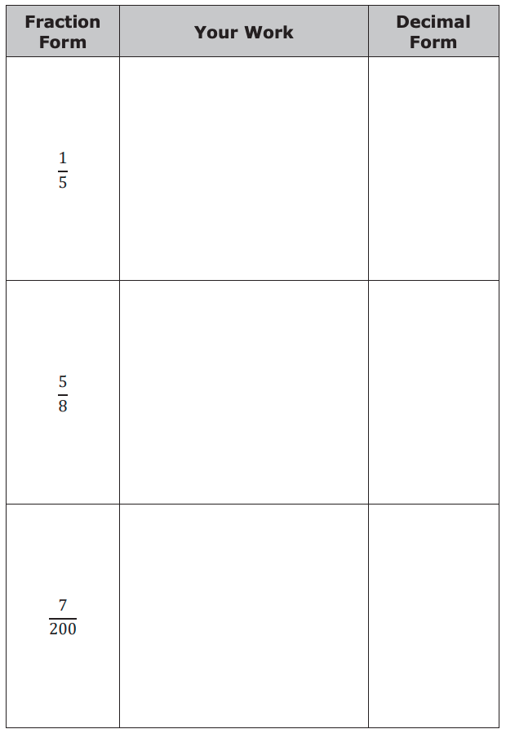
2. Complete the table by rewriting each fraction as its equivalent decimal.
volume 1, pg. 44

Slide 15
Guided Instruction
volume 1, pg. 45

Slide 16
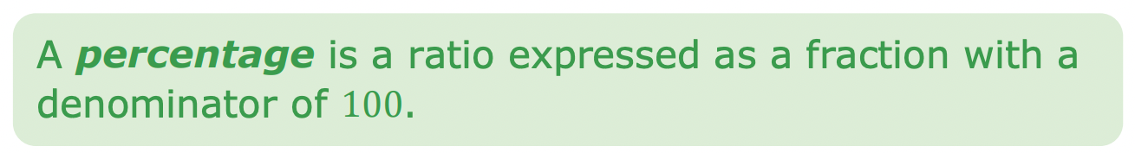
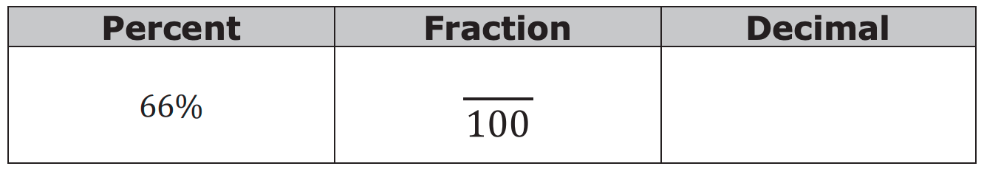
2.1.4 Guided Instruction: Decimal and Percentage Conversions
Percentages can also be written as fractions with a denominator of 100 or as a decimal.
1. Write 66% as a fraction and as a decimal.
To convert a decimal to a percent, multiply the decimal by 100.
volume 1, pg. 45

Slide 17
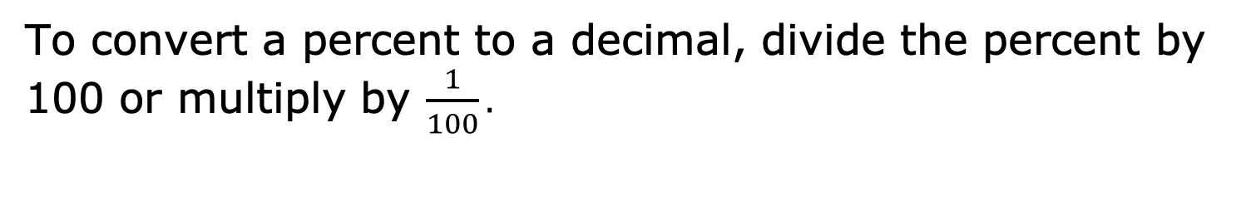
2. Convert the decimal 0.16 to a percent.
0.16 × ________
________%
To convert a percent to a decimal, divide the percent by 100 or multiply by $\frac{1}{100}.$
3. Convert 16.2% to a decimal.
16.2 ÷ ________ or 16.2 ∙ __________
__________
volume 1, pg. 45

Slide 18
Guided Practice
volume 1, pg. 45

Slide 19
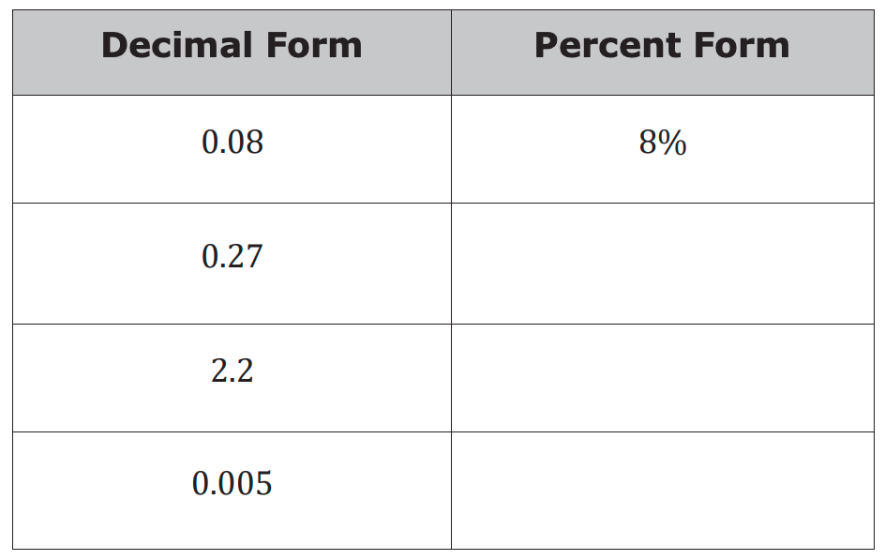
2.1.5 Guided Practice: Decimal and Percentage Conversions
Complete the table by converting each decimal to an equivalent percentage.
volume 1, pg. 45

Slide 20
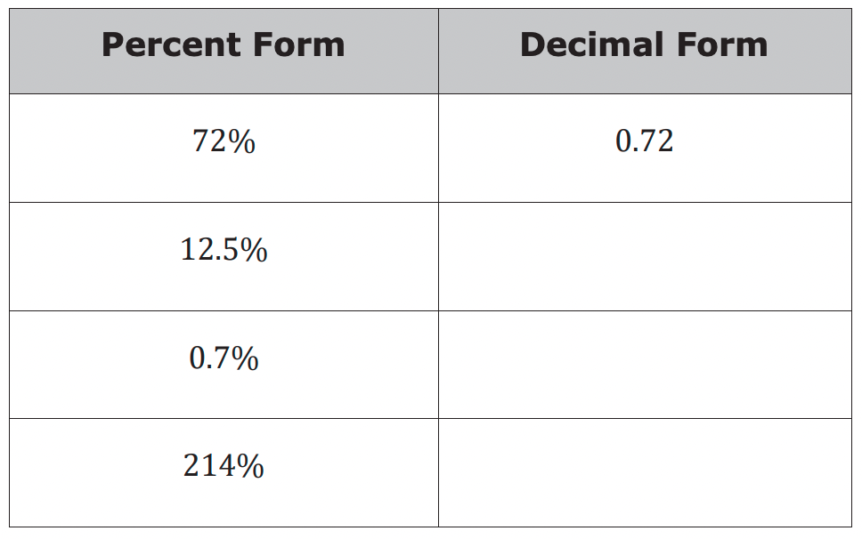
2. Rewrite each percentage into its equivalent decimal form to complete the table.
volume 1, pg. 45

Slide 21

Your Turn
volume 1, pg. 46

Slide 22
2.1.6 Your Turn!
1. Rewrite each percentage as a decimal.
a. 125.6%
b. 3%
2. Convert each decimal to an equivalent percentage.
a. 0.008
b. 4.71
volume 1, pg. 46

Slide 23
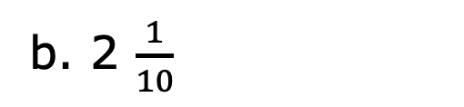
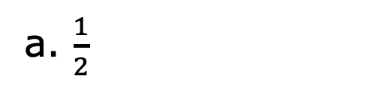
3. Rewrite each fraction as a decimal.
a. $\frac{1}{2}$
b. 2 $\frac{1}{10}$
4. Rewrite each decimal as an equivalent fraction. Simplify where applicable.
a. 0.94
b. 1.7
volume 1, pg. 46

Slide 24

Wrap-Up
volume 1, pg. 46

Slide 25
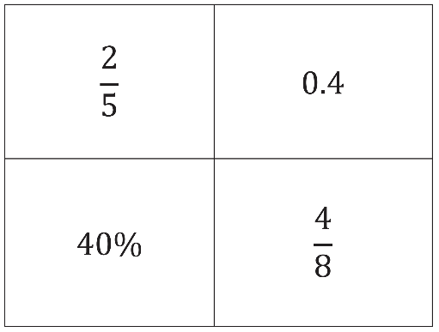
2.1.7 Wrap-Up: Ticket Out the Door
1. Circle the expression that does not belong.
2. Explain your reasoning for your choice.
volume 1, pg. 46

